Slide 1
14D_MotorTest
Motion control example
Nucleo_F401 and X-Nucleo_IHM04A1
With nBlocksStudio

Slide 2
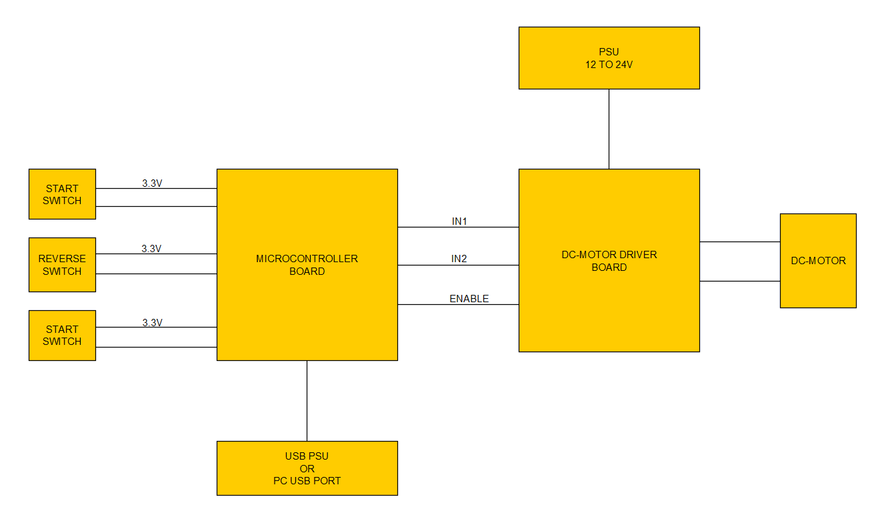
BLOCK DIAGRAM

Slide 3
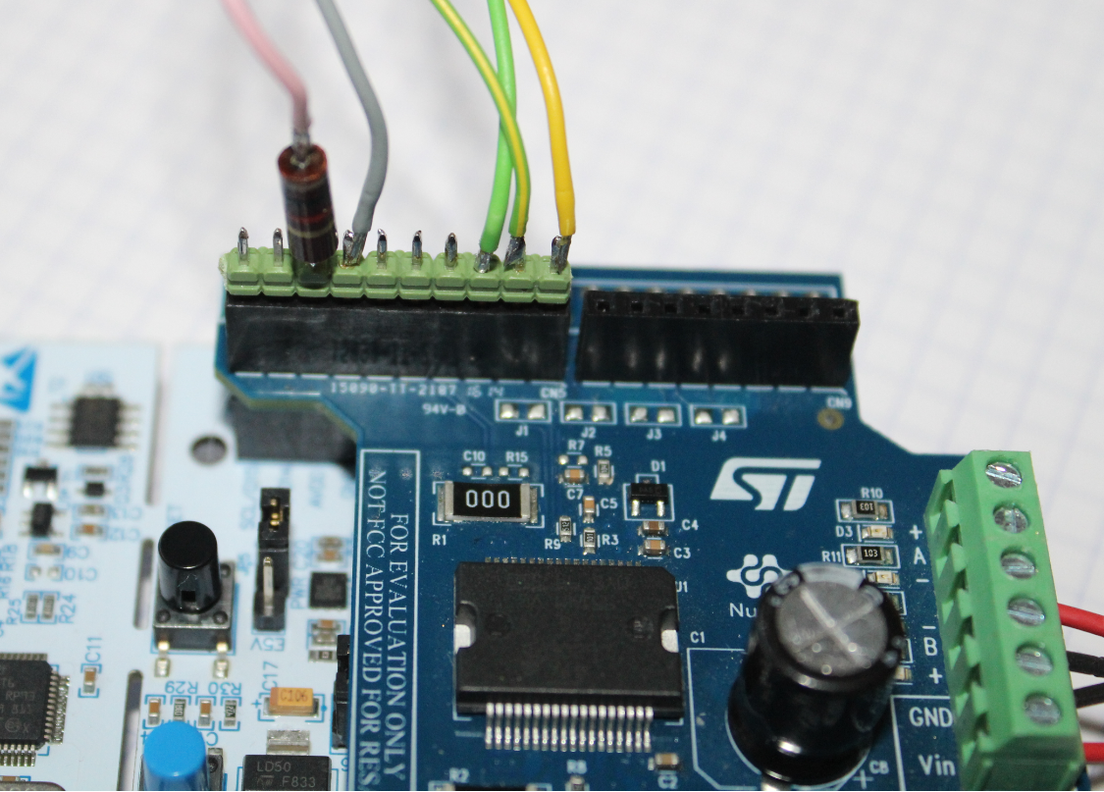
SWITCHES CONNECTION
3.3V
GROUND
REVERSE
START
STOP
1K RESISTOR IN SERIES
TO THE SWITCHES
PROTECTS THE BOARD
FROM SHORT-CIRCUIT
3.3V TO GND
1K Ohms

Slide 4
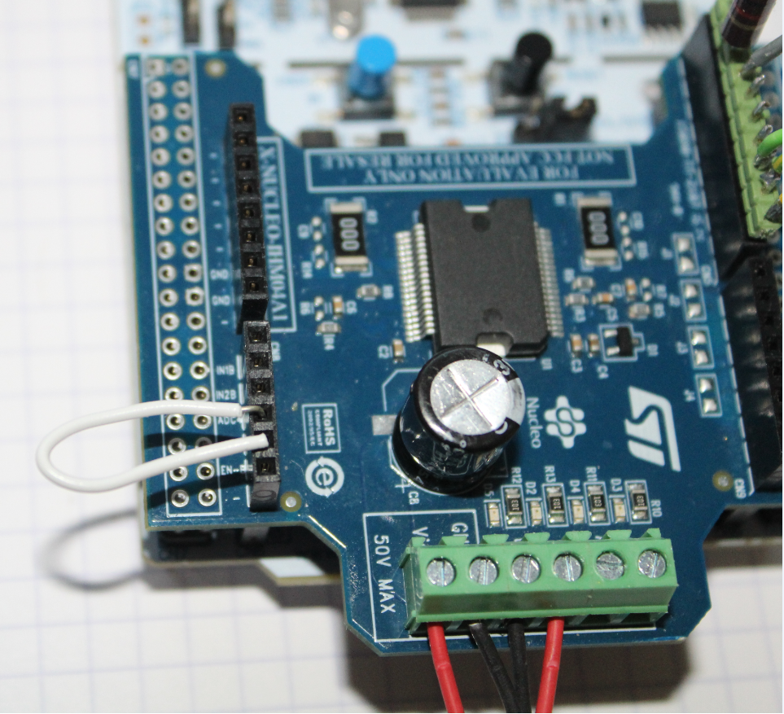
MOTOR-CONNECTIONS AND BRIDGE
12-24V
GROUND
MOTOR
MOTOR
BRIDGE
MANDATORY

Slide 5
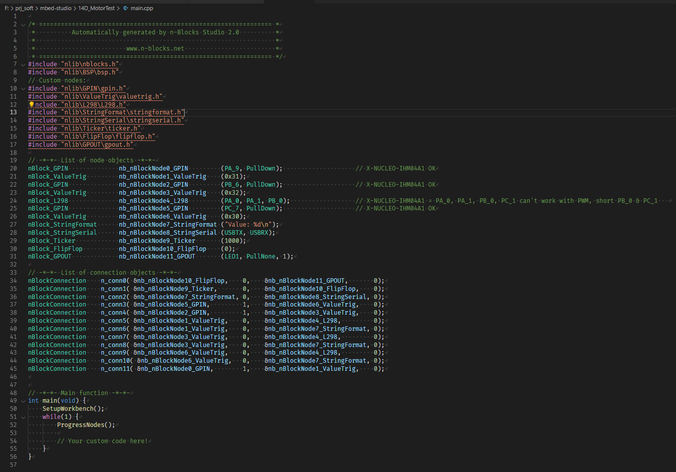
main.cpp

